Slide 1
Yearbook Layout Design
You must learn the rules before you break them

Slide 2
Yearbook Layout Design Rules
There are many ways to put together a yearbook
There are however, certain rules that must be followed to make it successful
In this lesson you will learn the Rules of Yearbook Layout Design

Slide 3
Yearbook Vocabulary
Spread
Two facing pages that form a visual unit.
Gutter
Extra pica between facing pages that allows for binding.
Eyeline (AKA visual center)
Horizontal line off of the true center established by one pica of white space.
All elements should “hang” off of this line except the dominant photo, which should be crossed by it.

Slide 4
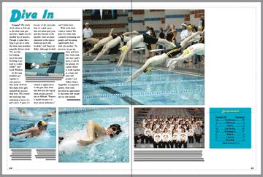
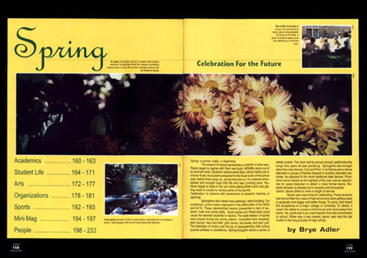
SPREAD

Slide 5
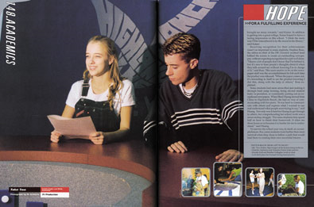
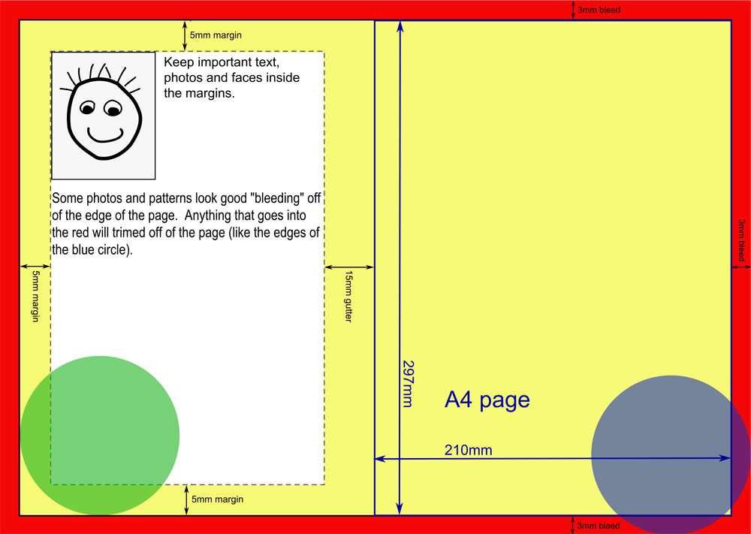
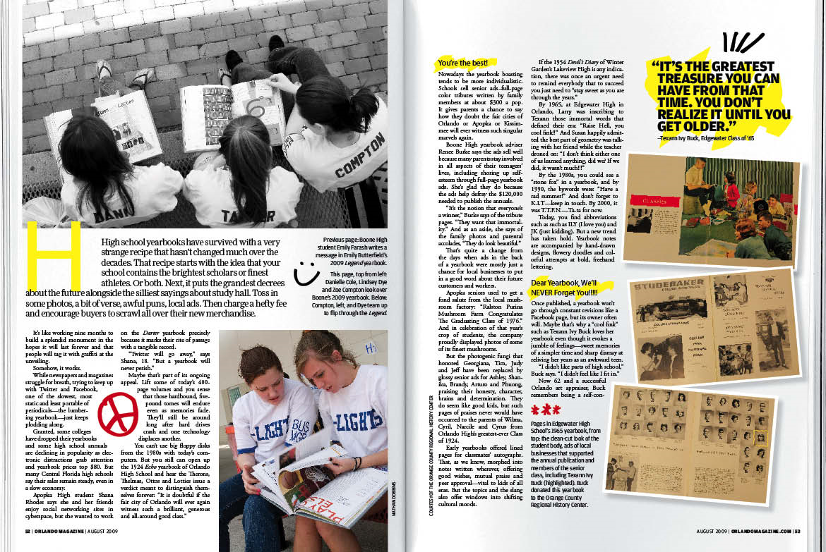
Gutter

Slide 6
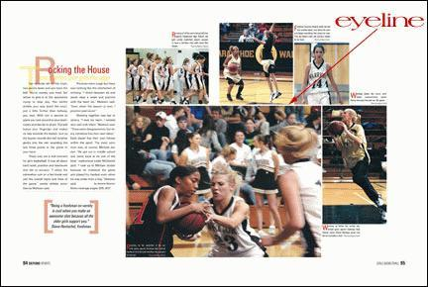
Eyeline

Slide 7
Design Elements
Photos
Images originating from a camera.
Photos form the core of the layout and should be designed first in a “pinwheel” formation.

Slide 8
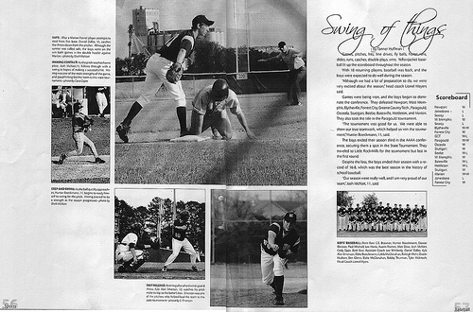
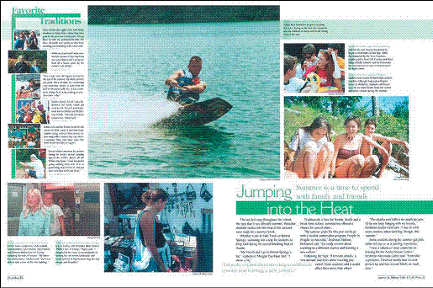
Photos in pinwheel

Slide 9
Yearbook Photography Rules
There must be a dominant photo (about twice the size of other photos)
Other photos should “hang” off of the dominant photo, the eyeline, and be grouped toward the center
ONLY 5-7 photos per spread , ONLY odd numbers
Leave room for captions near to EVERY photo.

Slide 10
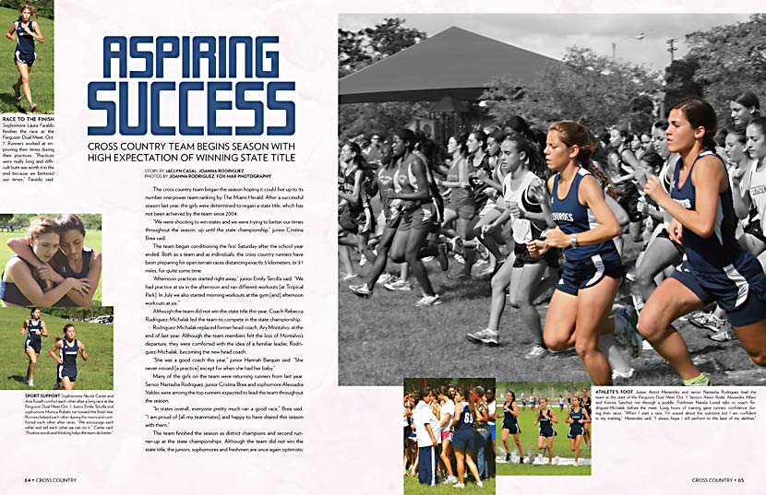
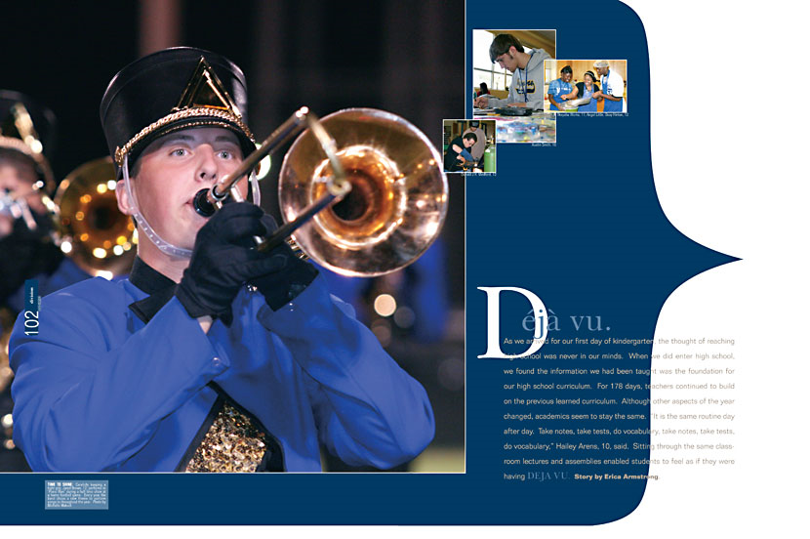
Dominant photo GOOD Examples

Slide 11
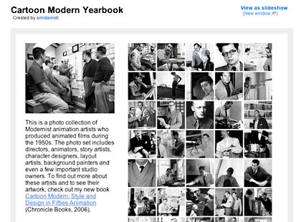
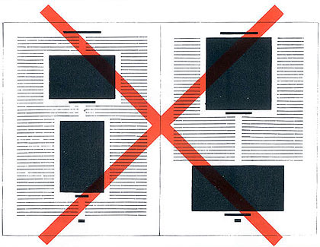
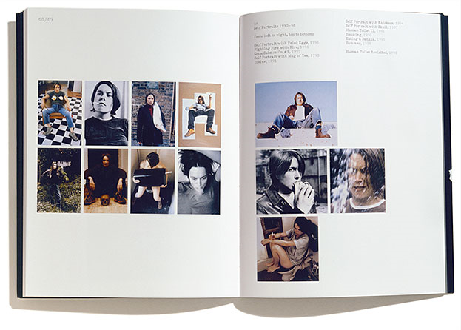
BAD Examples

Slide 12
Design Elements
Text
Display type such as headlines and titles should be large and attention getting.
Body text such as stories and captions should be smaller but easy to read.

Slide 13
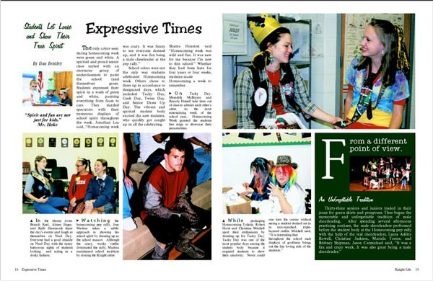
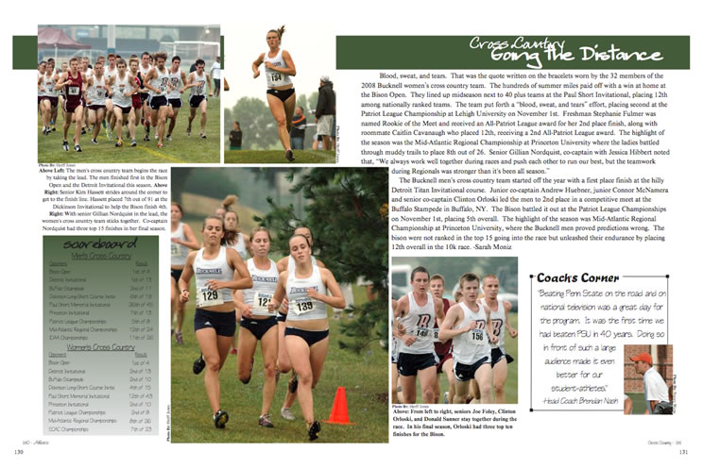
Text

Slide 14
Text Rules I
Headlines : Primary & Secondary
MUST include at least one verb
Must lead directly into lead idea of story
Titles
No verb necessary
Applies to the focus of the spread, not the story
Large, at least 24 points
Traditionally Sans-Serif fonts that match the spirit of the spread

Slide 15
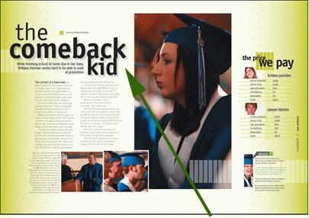
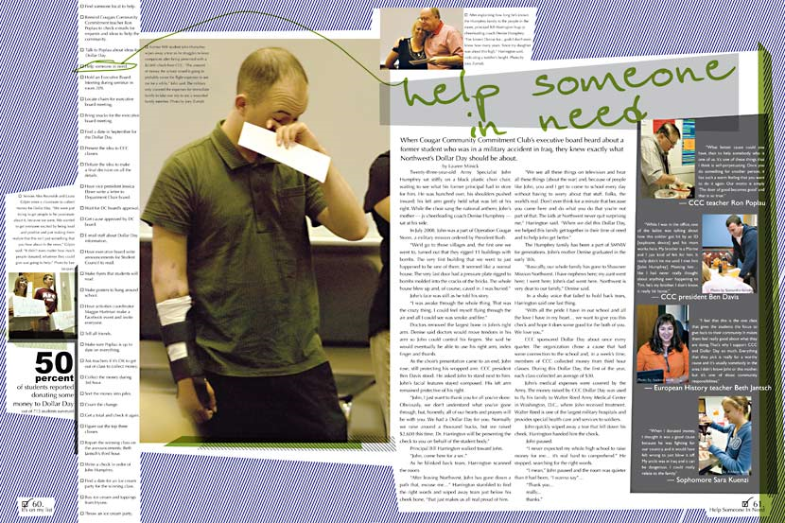
Headlines & Titles

Slide 16
Text Rules II
Body text
Body – the story text
Captions – blurbs beside photos
Bylines – photographer name/author name
Must be easily readable
Traditionally Serif font – with serifs
Should be split into small gray areas

Slide 17
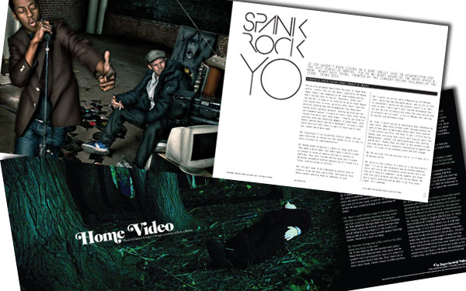
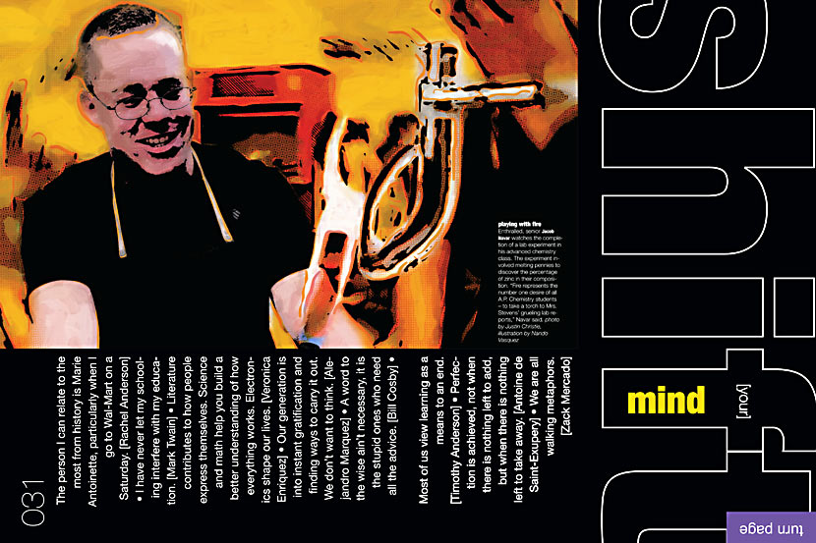
Body Text & Font

Slide 18
Design Elements
Art
Lines, boxes, gradients and drawings
should enhance a layout
should add meaning or order
Not merely decorations

Slide 19
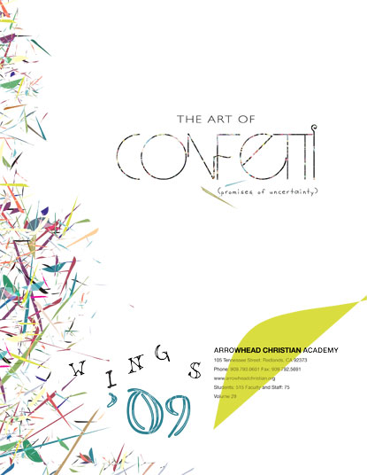
Art

Slide 20
Design Elements
White Space (AKA Negative Space)
An area of the layout that has
NO text, photos, or art.
Should be planned
Should be used as an effective way to separate elements
Should be used to lead the eye

Slide 21
White Space Rules
No trapped white space!! - make it purposeful
Consistent internal spacing - same throughout
USE white space to lead the eye
Use it to establish a 1 pica Eyeline - visual center
Use it to establish Simplicity

Slide 22
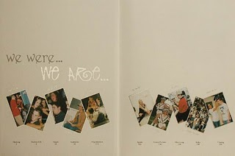
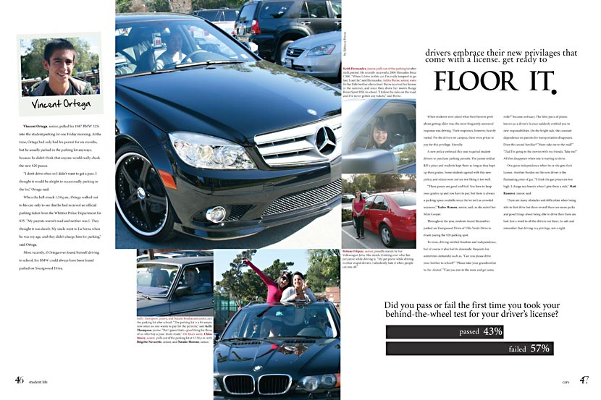
White Space

Slide 23
Art Rules
Illustration/Graphics
Should enhance, not merely decorate
Drawing/Graphic that takes place of photo or that gives information
Page elements
Often used to associate or dissociate from theme/idea/spirit
Rule lines MUST be consistent - use the internal software ruler

Slide 24
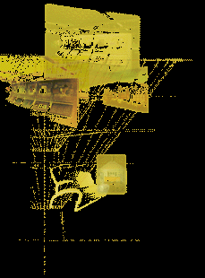
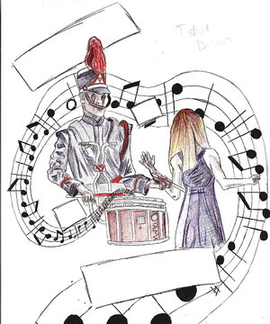
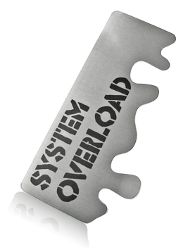
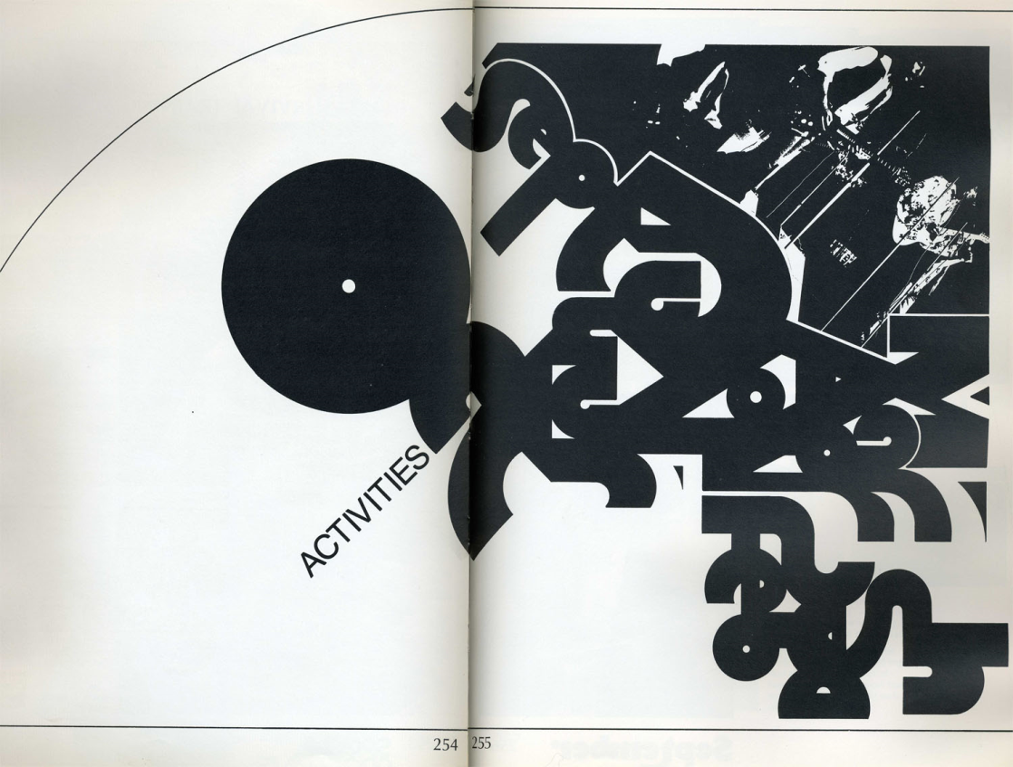
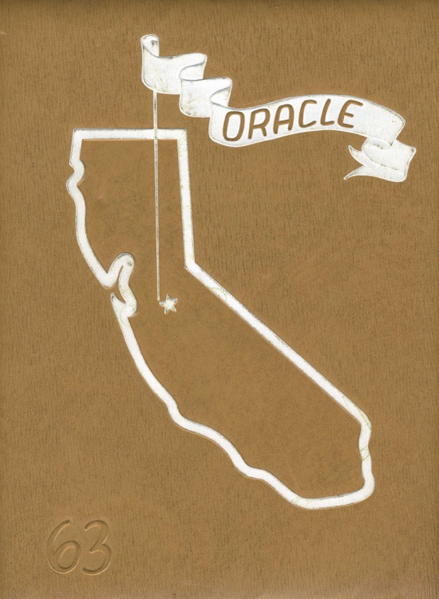
Graphics

Slide 25
Your Assignment
2 Mock Spreads
Use In-Design Software
Employ EACH of the elements from this PowerPoint.
You may use original photos that you have taken or will take, or may pull photos off the internet.
You may use graphics from the internet or create your own in PhotoShop.

Slide 26
Your Assignment, Continued
You MUST get your topics and layouts approved by Ms. Bailey
BEFORE getting on a computer!
Spread Map
You MUST map out your mock spread on paper before you begin computer work.
Design the photo layout and text placement
Plan the titles, headlines, etc.
20%

Slide 27
Your Assignment, Continued
Design elements
Each design element from this PowerPoint MUST be represented professionally.
70%
Print a copy of your spread and mark each design element with highlighters and include a legend.
ALSO, save computerized mock spread to Ms. Bailey’s folder. 10%
You have 3 weeks for this assignment. It IS your FINAL.

